Slide 1
Lab 4 Walkthrough

Slide 2
Lab 4 Components
Stored Procedures
Stored procedures are named blocks of database code that can be executed when needed.
Triggers
Triggers are named blocks of database code that execute automatically when a triggering event occurs.
We’ll learn stored procedure concepts, how to define them, how to give them parameters, using variables, what kinds of code can be included in them, embedding SQL in them, using them for business logic, and executing them.
We’ll learn about trigger concepts, what kind of code can be used in them, how to define the events that trigger them, using triggers for validation, and using triggers to maintain history.
Creating Normalized Tables
You combine database design with normalization to create a set of normalized tables.

Slide 3
PROCEDURE LANGUAGE background

Slide 4
SQL Versus Procedural Language
SQL | Procedural Language
Declarative | Imperative (more specifically, procedural)

Slide 5
SQL Versus Procedural Language
SQL | Procedural Language
Declarative | Imperative (more specifically, procedural)
Handled mostly by SQL query optimizer | Handled by a separate procedural engine

Slide 6
SQL Versus Procedural Language
SQL | Procedural Language
Declarative | Imperative (more specifically, procedural)
Handled mostly by SQL query optimizer | Handled by a separate procedural engine
Can invoke the procedural language in form of functions | Can contain SQL to select, insert, update, or delete data as part of the logic

Slide 7
SQL Versus Procedural Language
SQL | Procedural Language
Declarative | Imperative (more specifically, procedural)
Handled mostly by SQL query optimizer | Handled by a separate procedural engine
Can invoke the procedural language in form of functions | Can contain SQL to select, insert, update, or delete data as part of the logic
Constrained by the relational model | Allows for lists, nested tables, table variables, extended datatypes and the like

Slide 8
SQL Versus Procedural Language
SQL | Procedural Language
Declarative | Imperative (more specifically, procedural)
Handled mostly by SQL query optimizer | Handled by a separate procedural engine
Can invoke the procedural language in form of functions | Can contain SQL to select, insert, update, or delete data as part of the logic
Constrained by the relational model | Allows for lists, nested tables, table variables, extended datatypes and the like
Termed “SQL” in all relational databases | Termed “PL/SQL” in Oracle, “T-SQL (Transact SQL)” in SQL Server, and “PL/pgSQL” (amongst others) in Postgres

Slide 9
Section 1: stored procedures

Slide 10
Advantages of Stored Procedures
Reusability
Define once, reuse as needed
Division of Responsibility
Experts can specialize
Structural Independence
Can remove access to underlying tables
Performance
All executes within DBMS

Slide 11
Application versus Procedural Language
Application | Procedural Language
Logic all contained in application | Logic spread across application and database

Slide 12
Application versus Procedural Language
Application | Procedural Language
Logic all contained in application | Logic spread across application and database
Worse performance for larger datasets | Better performance for larger datasets

Slide 13
Application versus Procedural Language
Application | Procedural Language
Logic all contained in application | Logic spread across application and database
Worse performance for larger datasets | Better performance for larger datasets
More developed and powerful languages available | More restrictive and less developed language available

Slide 14
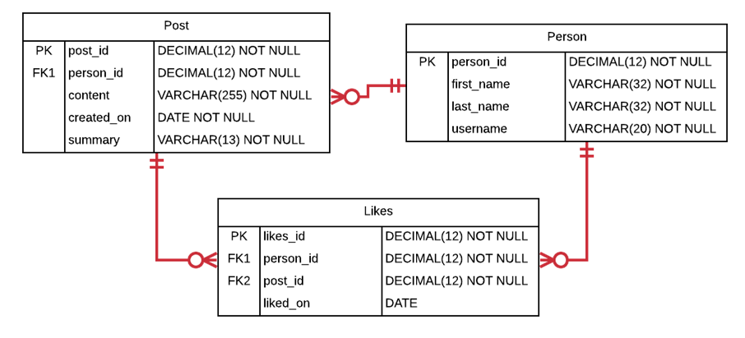
Lab Schema

Slide 15
StepS 1-2
Create Table Structure – Create the tables in the social networking schema, including all of their columns, datatypes, and constraints. Create sequences for each table; these will be used to generate the primary and foreign key values in Step #2.
Populate Tables – Populate the tables with data, ensuring that there are at least 5 people, at least 8 posts, and at least 4 likes. Make sure to use sequences to generate the primary and foreign key values. Most of the fields are self-explanatory. As far as the “content” field in Post, make them whatever you like, such as “Take a look at these new pics” or “Just arrived in the Bahamas”, and set the summary as the first 12 characters of the content, followed by “…”.

Slide 16
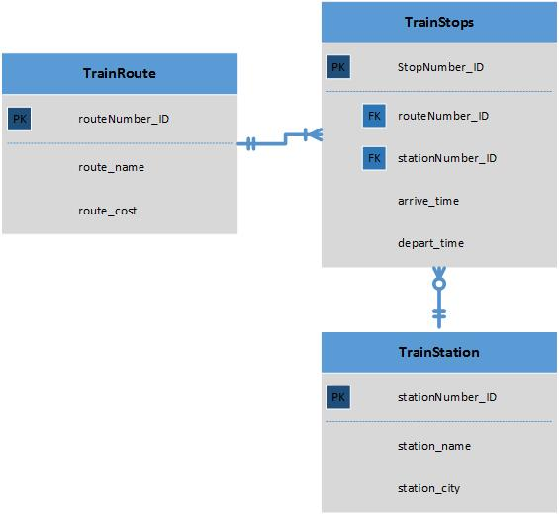
Simple Train Database

Slide 17
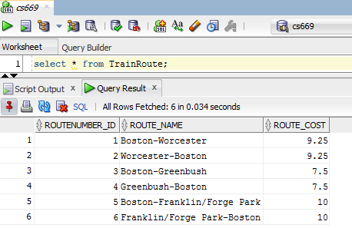
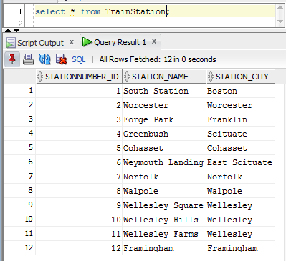
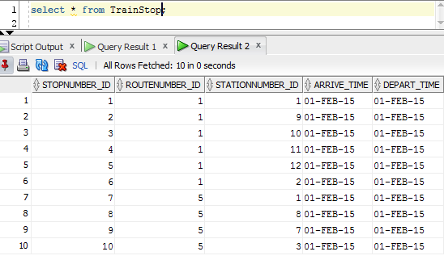
Viewing the Data

Slide 18
Database Sequence
A sequence is a database object capable of generating unique primary key values, and is the preferred mechanism for doing so.
Sequences generate unique whole numbers, starting with the first, and incrementing to the next number each time a new value is needed.
The database guarantees a sequence will not generate the same number twice, thus making the values unique and suitable for primary keys.
Real-world databases oftentimes have millions of rows in some tables; it is not practical to hardcode millions of values and ask a human being to keep generating them manually.

Slide 19
Creating a Sequence
Syntax: CREATE SEQUENCE <sequencename> START WITH 1;
Example: CREATE SEQUENCE train_station_seq START WITH 1;

Slide 20
Generating a Primary Key
Oracle Syntax: <sequencename>.nextval
Oracle Example: INSERT INTO TrainStation(stationNumber_ID, station_name, station_city)
VALUES(train_station_seq.nextval, 'TFGreen', 'Warwick');
MSSQL Syntax: NEXT VALUE FOR <sequencename>
MSSQL Example: INSERT INTO TrainStation(stationNumber_ID, station_name, station_city)
VALUES(NEXT VALUE FOR train_station_seq, 'TFGreen', 'Warwick');
Postgres Syntax: nextval('<sequencename>')
Postgres Example: INSERT INTO TrainStation(stationNumber_ID, station_name, station_city)
VALUES(nextval('train_station_seq'), 'TFGreen', 'Warwick');

Slide 21
Populating a Foreign Key – Method 1
Oracle Syntax: <sequencename>.currval
Oracle Example: INSERT INTO TrainStation(stationNumber_ID, station_name, station_city)
VALUES(train_station_seq.nextval, 'TFGreen', 'Warwick’);
INSERT INTO TrainRoute(routeNumber_ID, route_name, route_cost)
VALUES(train_route_seq.nextval, 'Boston-Greenbush’, 7.5);
INSERT INTO TrainStops(stopNumber_ID, routeNumber_ID, stationNumber_ID, arrive_time, depart_time)
VALUES(train_stops_seq.nextval, train_route_seq.currval, train_station_seq.currval,
'01-FEB-15', '01-FEB-15');

Slide 22
Populating a Foreign Key – Method 1
MSSQL Syntax: DECLARE <variablename> INT = NEXT VALUE FOR <sequencename>;
MSSQL Example:
DECLARE @train_station_seq INT = NEXT VALUE FOR train_station_seq;
DECLARE @train_route_seq INT = NEXT VALUE FOR train_route_seq;
INSERT INTO TrainStation(stationNumber_ID, station_name, station_city)
VALUES(@train_station_seq, 'TFGreen', 'Warwick’);
INSERT INTO TrainRoute(routeNumber_ID, route_name, route_cost)
VALUES(@train_route_seq, 'Boston-Greenbush’, 7.5);
INSERT INTO TrainStops(stopNumber_ID, routeNumber_ID, stationNumber_ID, arrive_time, depart_time)
VALUES(NEXT VALUE FOR train_stops_seq, @train_station_seq, @train_route_seq,
'01-FEB-15', '01-FEB-15');

Slide 23
Populating a Foreign Key – Method 1
Postgres Syntax: currval('<sequencename>’)
Postgres Example: INSERT INTO TrainStation(stationNumber_ID, station_name, station_city)
VALUES(nextval('train_station_seq'), 'TFGreen', 'Warwick’);
INSERT INTO TrainRoute(routeNumber_ID, route_name, route_cost)
VALUES(nextval('train_route_seq'), 'Boston-Greenbush’, 7.5);
INSERT INTO TrainStops(stopNumber_ID, routeNumber_ID, stationNumber_ID, arrive_time, depart_time)
VALUES(nexval('train_stops_seq’), currval('train_route_seq’), currval('train_station_seq'),
'01-FEB-15', '01-FEB-15');

Slide 24
Populating a Foreign Key – Method 2
INSERT INTO TrainStops(stopNumber_ID, routeNumber_ID, stationNumber_ID, arrive_time, depart_time)
VALUES(..., (SELECT routeNumber_ID from TrainRoute WHERE route_name = 'Boston-Greenbush’),
(SELECT stationNumber_ID from TrainStation WHERE station_name = ‘Greenbush’)
'01-FEB-15', '01-FEB-15');

Slide 25
Step 3
Create Hardcoded Procedure – Create a stored procedure named “add_michelle_stella” which has no parameters and adds a person named “Michelle Stella” to the Person table. Execute the stored procedure, and list out the rows in the Person table to show that Michelle Stella has been added.

Slide 26
Basic Oracle Stored Procedure
CREATE OR REPLACE PROCEDURE add_train_station_tfgreen
IS
BEGIN
INSERT INTO TrainStation(stationNumber_id,station_name, station_city)
VALUES(100, 'TFGreen', 'Warwick');
END;
BEGIN
ADD_TRAIN_STATION_TFGREEN;
END;
/

Slide 27
Basic SQL Server Procedure
CREATE OR ALTER PROCEDURE AddTrainStationTFGreen
AS
BEGIN
INSERT INTO TrainStation(stationNumber_id,station_name, station_city)
VALUES(100, 'TFGreen', 'Warwick');
END;
EXECUTE AddTrainStationTFGreen;

Slide 28
Basic Postgres Stored Procedure
CREATE OR REPLACE PROCEDURE add_train_station_tfgreen()
AS
$proc$
BEGIN
INSERT INTO TrainStation(stationNumber_id,station_name, station_city)
VALUES(100, 'TFGreen', 'Warwick’);
END;
$proc$ LANGUAGE plpgsql;
CALL add_train_station_tfgreen();

Slide 29
Step 4
Create Reusable Procedure – Create a reusable stored procedure named “add_person” that uses parameters and allows you to insert any new person into the Person table. Execute the stored procedure with a person of your choosing, then list out the Person table to show that the person was added to the table.

Slide 30
Reusable Stored Procedures
Hardcoding
Hardcoding all values is only useful in limited circumstances
Parameters
A parameter is a placeholder with a name and datatype
Defined At Execution
Parameters are assigned values at execution time
Repeatable Logic
We need repeatable logic to last the life of the database

Slide 31
Basic Oracle Reusable Procedure
CREATE OR REPLACE PROCEDURE add_train_station (
station_number_id IN DECIMAL,
station_name IN VARCHAR,
station_city IN VARCHAR)
IS
BEGIN
INSERT INTO TrainStation(stationNumber_id, station_name, station_city)
VALUES(station_number_id, station_name, station_city);
END;
BEGIN
add_train_station(100, 'TFGreen', 'Warwick’);
END;
/

Slide 32
Basic SQL Server Reusable Procedure
CREATE OR ALTER PROCEDURE AddTrainStation
@StationNumberId DECIMAL(12),
@StationName VARCHAR(50),
@StationCity VARCHAR(50)
AS
BEGIN
INSERT INTO TrainStation(stationNumber_id, station_name, station_city)
VALUES(@StationNumberId, @StationName, @StationCity);
END;
EXECUTE AddTrainStation 100, 'TFGreen', 'Warwick’;

Slide 33
Basic Postgres Reusable Stored Procedure
CREATE OR REPLACE PROCEDURE add_train_station(
station_number_id IN DECIMAL,
station_name IN VARCHAR,
station_city IN VARCHAR)
AS
$proc$
BEGIN
INSERT INTO TrainStation(stationNumber_id, station_name, station_city)
VALUES(station_number_id, station_name, station_city);
END;
$proc$ LANGUAGE plpgsql;
CALL ADD_TRAIN_STATION(100, 'TFGreen', 'Warwick’);

Slide 34
StepS 5-6
Create Deriving Procedure – Create a reusable stored procedure named “add_post” that uses parameters and allows you to insert any new post into the Post table. Instead of passing in the summary as a parameter, derive the summary from the content, storing the derivation temporarily in a variable (which is then used as part of the insert statement). Recall that the summary field stores the first 11 characters of the content followed by “…”. Execute the stored procedure to add a post of your choosing, then list out the Post table to show that the addition succeeded.
Create Lookup Procedure – Create a reusable stored procedure named “add_like” that uses parameters and allows you to insert any new “like”. Rather than passing in the person_id value as a parameter to identify which person is liking which post, pass in the username of the person. The stored procedure should then lookup the person_id and store it in a variable to be used in the insert statement. Execute the procedure to add a “like” of your choosing, then list out the Like table to show the addition succeeded.

Slide 35
Variable Basics
A variable is a named placeholder that can store a value, and can later be referenced by name to retrieve the stored value.
A variable declaration identifies the existence, name, and datatype of the variable. A variable cannot be used unless it is first declared.
A variable assignment places a value into the variable. Referencing the variable later will use the value assigned.
Referencing a variable by name uses whatever value is in the variable.

Slide 36
Station Code
Imagine we added an additional column to the train station table, station code, that is three characters long.
The station code is the first three characters of the train station’s name.
We can use a variable to calculate this automatically instead of passing this in as a parameter.

Slide 37
Enhanced add_train_station (Oracle)
CREATE OR REPLACE PROCEDURE add_train_station (
station_number_id IN DECIMAL,
station_name IN VARCHAR,
station_city IN VARCHAR)
IS
v_station_code VARCHAR(3); --Declare a variable to hold the code.
BEGIN
--Calculate the variable’s value.
v_station_code := SUBSTR(station_name, 1, 3);
INSERT INTO TrainStation(stationNumber_id, station_name, station_city, station_code)
VALUES(station_number_id, station_name, station_city, v_station_code);
END;
BEGIN
add_train_station(100, 'TFGreen', 'Warwick’); --Code is automatically ‘TFG’
END;
/

Slide 38
Enhanced add_train_station (SQL Server)
CREATE OR ALTER PROCEDURE AddTrainStation
@StationNumberId DECIMAL(12),
@StationName VARCHAR(50),
@StationCity VARCHAR(50)
AS
BEGIN
DECLARE @VStationCode VARCHAR(3); --Declare a variable to hold the code. --Calculate the code.
SET @VStationCode= SUBSTRING(@StationName, 1, 3);
INSERT INTO TrainStation(stationNumber_id, station_name, station_city, station_code)
VALUES(@StationNumberId, @StationName, @StationCity, @VStationCode);
END;
EXECUTE AddTrainStation 100, 'TFGreen', 'Warwick’; --Station code is ‘TFG’

Slide 39
Enhanced add_train_station (Postgres)
CREATE OR REPLACE PROCEDURE add_train_station(
station_number_id IN DECIMAL,
station_name IN VARCHAR,
station_city IN VARCHAR)
AS
$proc$
DECLARE
v_station_code VARCHAR(3); --Declare a variable to hold the code.
BEGIN
v_station_code := SUBSTRING(station_name FROM 1 FOR 3); --Calculate the code.
INSERT INTO TrainStation(stationNumber_id, station_name, station_city, station_code)
VALUES(station_number_id, station_name, station_city, v_station_code);
END;
$proc$ LANGUAGE plpgsql
CALL ADD_TRAIN_STATION(100, 'TFGreen', 'Warwick’); --Station code is ‘TFG’

Slide 40
Multi-Step Logic
Simple inserts are useful, though sometimes stored procedures contain many steps.
An entire transaction’s logic can be encapsulated in one stored procedure.
Example: Delete an employee and all associated table rows in a payroll system.

Slide 41
Robust Procedures
Robust procedures check for errors and conditions before blindly executing.
Robust procedures are commented so that the caller knows why it exists and what it does.
Robust procedures take into account both common cases and edge cases.

Slide 42
Section 2: TRiggers

Slide 43
Triggers
Reusable, Triggered Logic
Triggers are reusable logic triggered by specific events
Many Uses
Histories, validations, maintaining denormalized tables, more…
Many Drawbacks
Same transaction execution, increased time, unexpected logic
Notes:
One key difference between a trigger and a stored procedure is that all triggers are associated to an event that determines when its code is executed.
The specific event is defined as part of the overall definition of the trigger when it is created. The database then automatically invokes the trigger when the defined event occurs.
We cannot directly execute a trigger.
Although triggers are powerful, because of the associated drawbacks, it is a best practice to reserve the use of triggers to situations where there is no other practical alternative.
Perhaps we want to add functionality to a two-decade-old application’s database access logic.
Perhaps the same database schema is updated from several different applications, and we cannot practically add the same business logic to all of them.
Perhaps an application that accesses our database is proprietary, but we want to perform some logic when the application accesses the database.

Slide 44
Types of Triggers
Oracle, SQL Server, and Postgres support AFTER and INSTEAD OF triggers.
An AFTER trigger is invoked after the statement has been applied, and can be used to validate the values or insert into additional tables as needed.
An INSTEAD OF trigger is invoked as a replacement of the DML that triggered it, and is useful to provide alternative DML or to update views.

Slide 45
Before and Row-Level Triggers
Oracle and Postgres support before and row-level triggers.
A before row-level trigger is executed before the statement fires once for each row, and can be used to modify the values before they are applied to the database.
Multiple before triggers can fire, so before triggers cannot necessarily see the final value that will be applied (not suitable for validation or extra table insertion).

Slide 46
StepS 7-9

Slide 47
Pseudo Records
Oracle and Postgres give access to pseudo records in row-level triggers, which are effectively single row tables with the same columns as the triggering tables.
SQL Server gives access to pseudo records in all triggers, which are tables containing the same columns as the triggering table, and containing all affected rows.

Slide 48
Oracle Pseudo Records
:NEW
For an INSERT statement, contains the inserted values.
:OLD
Not available for an INSERT statement.
For an UPDATE statement, contains the values before the update.
For an UPDATE statement, contains the new values after the update (note that multiple before triggers can execute changing the new value).
Not available in a DELETE statement.
Can be modified in a before trigger only.
For a DELETE statement, contains the values before the delete.

Slide 49
Postgres Pseudo Records
NEW
For an INSERT statement, contains the inserted values.
OLD
Null for an INSERT statement.
For an UPDATE statement, contains the values before the update.
For an UPDATE statement, contains the new values after the update (note that multiple before triggers can execute changing the new value).
Null in a DELETE statement.
Can be used as a basis for keeping or changing the values.
For a DELETE statement, contains the values before the delete.

Slide 50
SQL Server Pseudo Records
INSERTED
For an INSERT statement, contains the inserted rows.
DELETED
Available but contains no rows for an INSERT statement.
For an UPDATE statement, contains the rows before the update.
For an UPDATE statement, contains the new rows after the update.
Available but contains no rows in a DELETE statement.
For a DELETE statement, contains the deleted rows.

Slide 51
Modifying Values
In Oracle, use a before row-level trigger and change the values in the :NEW pseudo record to modify the transaction’s values.
In SQL Server, it’s necessary to use an INSTEAD OF trigger to modify the transaction’s values.
In Postgres, return a record with altered values from the triggered function to modify the transaction’s values.

Slide 52
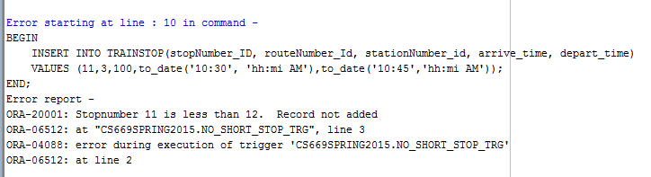
Sample Oracle Validation Trigger
CREATE OR REPLACE TRIGGER NO_SHORT_STOP_TRG
AFTER INSERT OR UPDATE ON TRAINSTOP
FOR EACH ROW
BEGIN
IF :NEW.stopNumber_ID < 12 THEN
RAISE_APPLICATION_ERROR(-20001,'Stopnumber ' || :NEW.stopNumber_ID || ' is less than 12. Record not added');
END IF;
END;
/

Slide 53
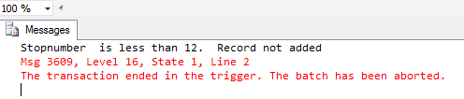
Sample SQL Server Validation Trigger
CREATE TRIGGER NO_SHORT_STOP_TRG
ON TrainStop AFTER INSERT
AS
DECLARE
@stopNumber Decimal
BEGIN
set @stopNumber = (Select stopNumber_ID from inserted);
if @stopNumber < 12
BEGIN
ROLLBACK
RAISERROR('Stopnumber is less than 12. Record not added', -1,1);
END;
END

Slide 54
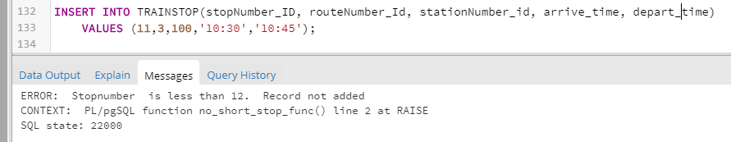
Sample Postgres Validation Trigger
CREATE OR REPLACE FUNCTION NO_SHORT_STOP_FUNC()
RETURNS TRIGGER LANGUAGE plpgsql
AS $trigfunc$
BEGIN RAISE EXCEPTION USING MESSAGE = 'Stopnumber is less than 12. Record not added', ERRCODE = 22000;
END;
$trigfunc$;
CREATE TRIGGER NO_SHORT_STOP_TRG
AFTER UPDATE OR INSERT ON TrainStop
FOR EACH ROW WHEN(new. stopNumber_ID < 12)
EXECUTE PROCEDURE NO_SHORT_STOP_FUNC();

Slide 55
Typical Uses of Triggers
Auditing
Validating
Enforcing advanced referential integrity
Enforcing complex business rules
Logging
Deriving values for cross-table derived values
Maintaining histories

Slide 56
Section 3: normalization

Slide 57
Step 10
Creating Normalized Table Structure – For this question, you create a set of normalized tables based upon the scenario given, and also identify some functional dependencies between the given fields. This scenario involves a court which handles cases between a plaintiff and defendant....

Slide 58
This is Primarily a Design Problem
You are given a set of flat fields and business rules, and are asked to come up with a table structure and normalize it.
First and foremost, you are asked to design a database.
Although not required, it can be helpful to come up with structural database rules to define the entities and relationships, then map to a DBMS physical ERD.
Then apply normalization as the last step.

Slide 59

End

